Slide 1
Software Development Life Cycle(SDLC)
(5 hours)
Notes:
Title - The learning outcome
Subtitle - Duration

Slide 2
In this section, we will discuss:
SDLC Overview
Phases of Software Development Life Cycle (SDLC)
Software Development Life Cycle Models
Software Test Levels
Notes:
Mention the parent topics one by one. This particular learning outcome has 4 parent topics.

Slide 3
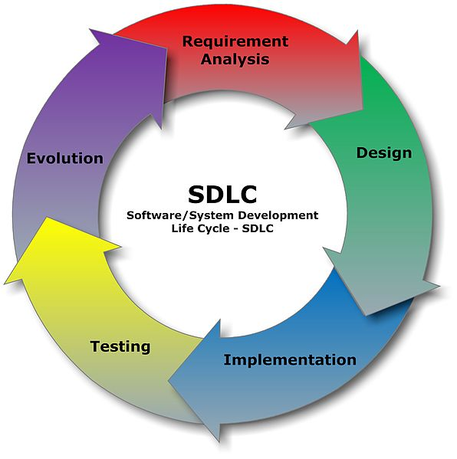
SDLC Overview
What is SDLC?
SDLC is a process followed for a software project, within a software organization.
It consists of a detailed plan describing how to develop, maintain, replace and alter or enhance specific software. .
Image Source:
https://commons.wikimedia.org/wiki/File:SDLC_-_Software_Development_Life_Cycle.jpg
Notes:
Left (White Color space):
Title - Parent Topic
Subtitle - Subtopic 1
Body Text - Description in bullets
Right (Grey Color Space):
Body Text - Relevant image (with source)/code snippet
Software Development Life Cycle (SDLC) is a process used by the software industry to design, develop and test high quality softwares. The SDLC aims to produce a high-quality software that meets or exceeds customer expectations, reaches completion within times and cost estimates.
SDLC is the acronym of Software Development Life Cycle.
It is also called as Software Development Process.
SDLC is a framework defining tasks performed at each step in the software development process.
ISO/IEC 12207 is an international standard for software life-cycle processes. It aims to be the standard that defines all the tasks required for developing and maintaining software.
Reference:
https://commons.wikimedia.org/wiki/File:SDLC_-_Software_Development_Life_Cycle.jpg

Slide 4
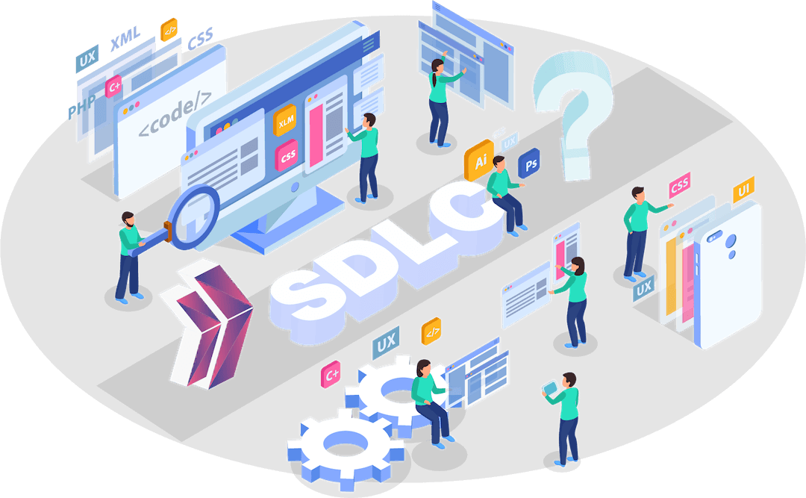
SDLC Overview
Why SDLC?
Improved client relations
Provides a framework for a standard set of activities and deliverables
Increased and enhance development speed
Image Source:
https://clarusway.com/what-is-software-development-life-cycle/
Notes:
This slide talks about the case if we have to divide a subtopic further.
Left (White Color space):
Title - Parent Topic
Subtitle - Subtopic 2
Body Text - Description in bullets
Right (Grey Color Space):
Body Text - Relevant image (with source)/code snippet
It offers a basis for project planning, scheduling, and estimating
Provides a framework for a standard set of activities and deliverables
It is a mechanism for project tracking and control
Increases visibility of project planning to all involved stakeholders of the development process
Increased and enhance development speed
Improved client relations
Helps you to decrease project risk and project management plan overhead
Reference:
https://clarusway.com/what-is-software-development-life-cycle/

Slide 5
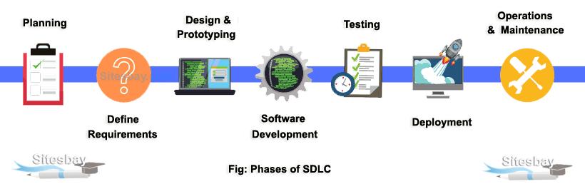
Phases of Software Development Life Cycle (SDLC)
Phases of SDLC
Phase 1: Requirement collection and analysis
Phase 2: Feasibility study
Phase 3: Design
Phase 4: Coding
Phase 5: Testing
Phase 6: Installation/Deployment
Phase 7: Maintenance
Image Source:
https://www.sitesbay.com/software-engineering/se-phases-of-sdlc
Notes:
Left (White Color space):
Title - Parent Topic
Subtitle - Subtopic 1
Body Text - Description in bullets
Right (Grey Color Space):
Body Text - Relevant image (with source)/code snippet
Phases of SDLC:
Stage1: Planning and requirement analysis
Requirement Analysis is the most important and necessary stage in SDLC.
The senior members of the team perform it with inputs from all the stakeholders and domain experts or SMEs in the industry.
Planning for the quality assurance requirements and identifications of the risks associated with the projects is also done at this stage.
Business analyst and Project organizer set up a meeting with the client to gather all the data like what the customer wants to build, who will be the end user, what is the objective of the product. Before creating a product, a core understanding or knowledge of the product is very necessary.
For Example, A client wants to have an application which concerns money transactions. In this method, the requirement has to be precise like what kind of operations will be done, how it will be done, in which currency it will be done, etc.
Once the required function is done, an analysis is complete with auditing the feasibility of the growth of a product. In case of any ambiguity, a signal is set up for further discussion.
Once the requirement is understood, the SRS (Software Requirement Specification) document is created. The developers should thoroughly follow this document and also should be reviewed by the customer for future reference.
Stage2: Defining Requirements
Once the requirement analysis is done, the next stage is to certainly represent and document the software requirements and get them accepted from the project stakeholders.
This is accomplished through "SRS"- Software Requirement Specification document which contains all the product requirements to be constructed and developed during the project life cycle.
Stage3: Designing the Software
The next phase is about to bring down all the knowledge of requirements, analysis, and design of the software project. This phase is the product of the last two, like inputs from the customer and requirement gathering.
Stage4: Developing the project
In this phase of SDLC, the actual development begins, and the programming is built. The implementation of design begins concerning writing code. Developers have to follow the coding guidelines described by their management and programming tools like compilers, interpreters, debuggers, etc. are used to develop and implement the code.
Stage5: Testing
After the code is generated, it is tested against the requirements to make sure that the products are solving the needs addressed and gathered during the requirements stage.
During this stage, unit testing, integration testing, system testing, acceptance testing are done.
Stage6: Deployment
Once the software is certified, and no bugs or errors are stated, then it is deployed.
Then based on the assessment, the software may be released as it is or with suggested enhancement in the object segment.
After the software is deployed, then its maintenance begins.
Stage7: Maintenance
Once when the client starts using the developed systems, then the real issues come up and requirements to be solved from time to time.
This procedure where the care is taken for the developed product is known as maintenance.
Reference:
https://www.sitesbay.com/software-engineering/se-phases-of-sdlc

Slide 6
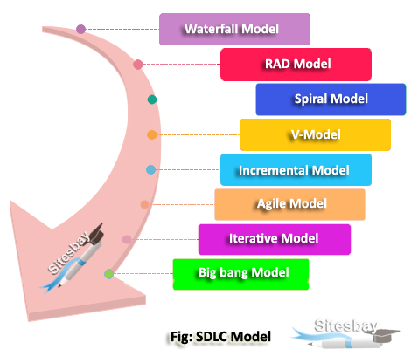
Software Development Life Cycle models
SDLC Models
Waterfall Model
Iterative Model
V-Shaped Model
Spiral Model
Agile Model
Big Bang.Model
Image Source:
https://www.sitesbay.com/software-engineering/se-what-is-sdlc-model
Notes:
Left (White Color space):
Title - Parent Topic
Subtitle - Subtopic 1
Body Text - Description in bullets
Right (Grey Color Space):
Body Text - Relevant image (with source)/code snippet
There are different software development life cycle models specify and design, which are followed during the software development phase. These models are also called "Software Development Process Models.
Reference:
https://www.sitesbay.com/software-engineering/se-what-is-sdlc-model

Slide 7
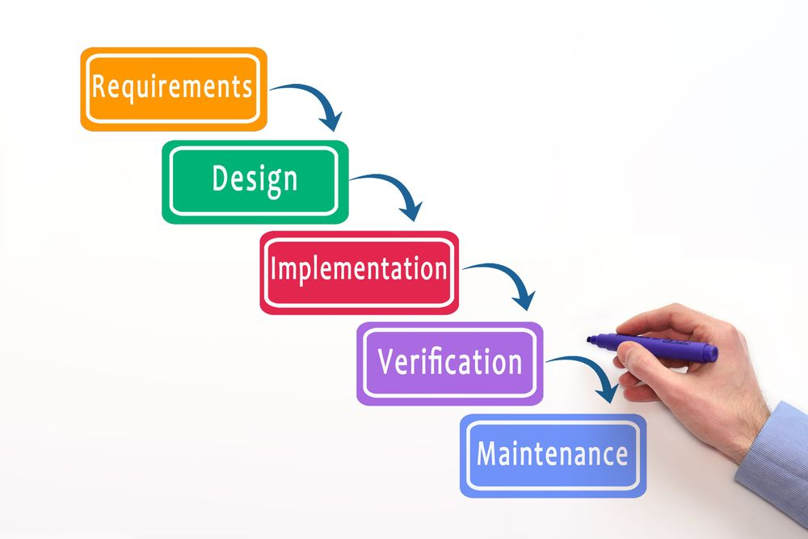
SDLC Models
Waterfall Model
Waterfall Model is a sequential model that divides software development into pre-defined phases.
Each phase must be completed before the next phase can begin with no overlap between the phases
Image Source:
https://gearheart.io/articles/7-phases-software-development-life-cycle-sdlc/
Notes:
This slide talks about the case if we have to divide a subtopic further.
Left (White Color space):
Title - Parent Topic
Subtitle - Subtopic of Subtopic
Body Text - Description in bullets
Right (Grey Color Space):
Body Text - Relevant image (with source)/code snippet
This model has five phases: Requirements analysis and specification, design, implementation, and unit testing, integration and system testing, and operation and maintenance. The steps always follow in this order and do not overlap. The developer must complete every phase before the next phase begins. This model is named "Waterfall Model", because its diagrammatic representation resembles a cascade of waterfalls.
Reference:
https://gearheart.io/articles/7-phases-software-development-life-cycle-sdlc/

Slide 8
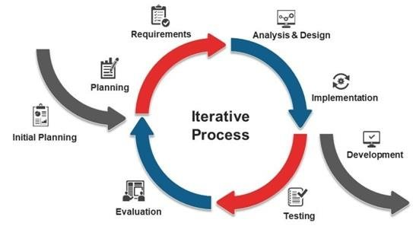
SDLC Models
Iterative Model
A subset of the final product under development, which grows from iteration to iteration to become the final product or software
Image Source:
https://www.researchgate.net/figure/SDLC-Iterative-Model-2_fig4_338710620
Notes:
Left (White Color space):
Title - Parent Topic
Subtitle - Subtopic of Subtopic
Body Text - Description in bullets
Right (Grey Color Space):
Body Text - Relevant image (with source)/code snippet
An iterative life cycle model does not attempt to start with a full specification of requirements. Instead, development begins by specifying and implementing just part of the software, which can then be reviewed in order to identify further requirements. This process is then repeated, producing a new version of the software for each cycle of the model.
Reference:
https://www.researchgate.net/figure/SDLC-Iterative-Model-2_fig4_338710620

Slide 9
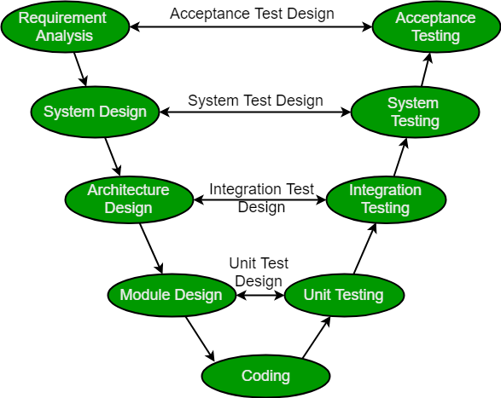
SDLC Models
V-Shaped Model
The V-model is a type of SDLC model where process executes in a sequential manner in V-shape.
It is also known as Verification and Validation model.
Image Source:
https://www.geeksforgeeks.org/software-engineering-sdlc-v-model/
Notes:
Left (White Color space):
Title - Parent Topic
Subtitle - Subtopic of Subtopic
Body Text - Description in bullets
Right (Grey Color Space):
Body Text - Relevant image (with source)/code snippet
V Model is a highly disciplined SDLC model in which there is a testing phase parallel to each development phase. The V model is an extension of the waterfall model in which testing is done on each stage parallel with development in a sequential way. It is known as the Validation or Verification Model.
Reference:
https://www.geeksforgeeks.org/software-engineering-sdlc-v-model/

Slide 10
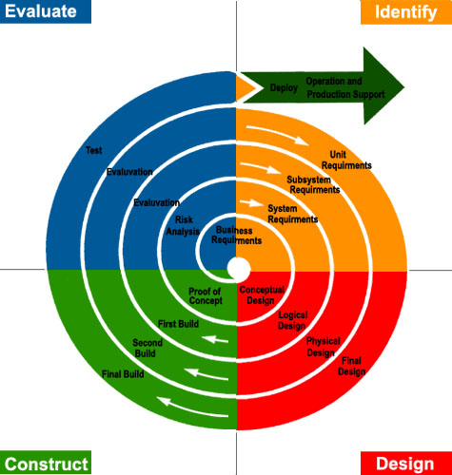
SDLC Models
Spiral Model
The spiral model is a systems development lifecycle (SDLC) method used for risk management that combines the iterative development process model with elements of the Waterfall model.
Image Source:
https://eternalsunshineoftheismind.files.wordpress.com/2013/02/i-s-spiral.jpg
Notes:
Left (White Color space):
Title - Parent Topic
Subtitle - Subtopic of Subtopic
Body Text - Description in bullets
Right (Grey Color Space):
Body Text - Relevant image (with source)/code snippet
Spiral model is one of the most important Software Development Life Cycle models, which provides support for Risk Handling. In its diagrammatic representation, it looks like a spiral with many loops. The exact number of loops of the spiral is unknown and can vary from project to project. Each loop of the spiral is called a Phase of the software development process.
Reference:
https://eternalsunshineoftheismind.files.wordpress.com/2013/02/i-s-spiral.jpg

Slide 11
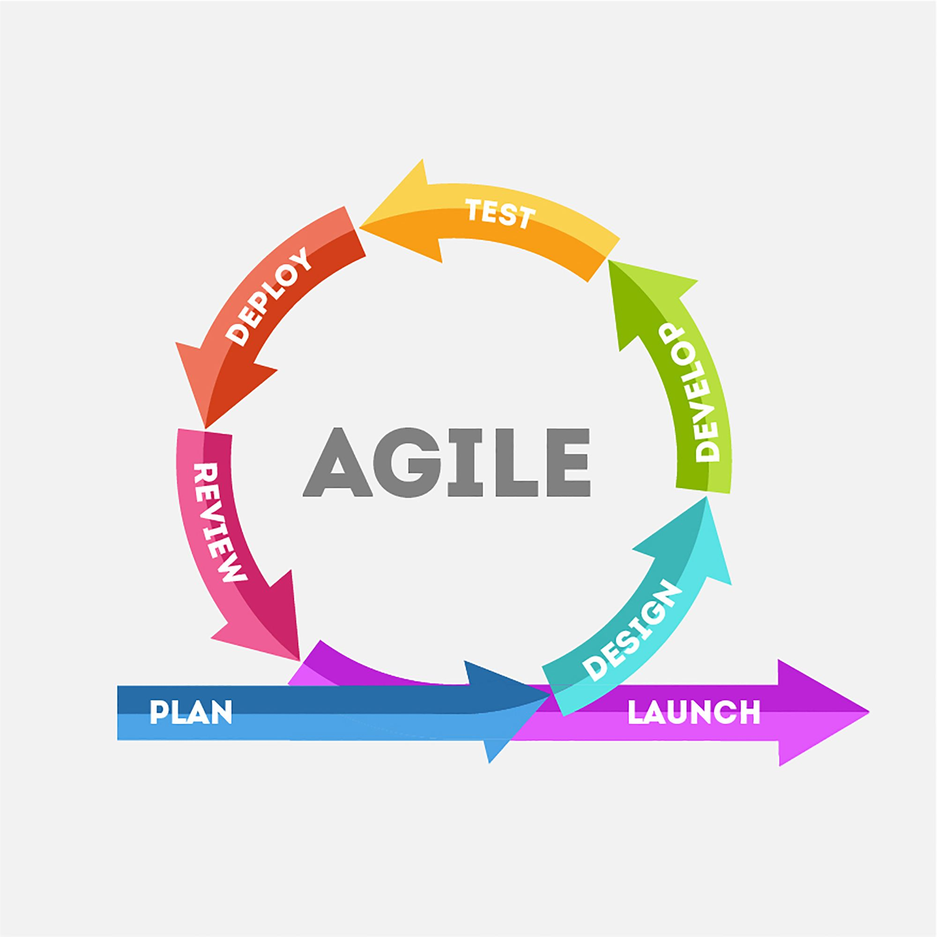
SDLC Models
Agile Model
Agile SDLC methodology is based on collaborative decision making between requirements and solutions teams, and a cyclical, iterative progression of producing working software.
Image Source:
https://gearheart.io/articles/7-phases-software-development-life-cycle-sdlc/
Notes:
Left (White Color space):
Title - Parent Topic
Subtitle - Subtopic of Subtopic
Body Text - Description in bullets
Right (Grey Color Space):
Body Text - Relevant image (with source)/code snippet
Agile development model is also a type of Incremental model. Software is developed in incremental, rapid cycles. This results in small incremental releases with each release building on previous functionality. Each release is thoroughly tested to ensure software quality is maintained. It is used for time critical applications.
Reference:
https://gearheart.io/articles/7-phases-software-development-life-cycle-sdlc/

Slide 12
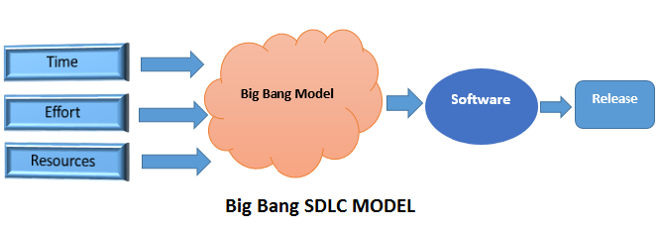
SDLC Models
Bing Bang Model
The Big bang model is an SDLC model that starts from nothing.
It is the simplest model in SDLC as it requires almost no planning
Image Source:
https://www.professionalqa.com/big-bang-sdlc-model
Notes:
Left (White Color space):
Title - Parent Topic
Subtitle - Subtopic of Subtopic
Body Text - Description in bullets
Right (Grey Color Space):
Body Text - Relevant image (with source)/code snippet
The Big Bang Model is popular in situations or adopted when the project's stakeholders or customers are not certain regarding their wants and requirements. They have also haven't analyzed all the essential features and characteristics that they plan to incorporate into their system. In this model, all or most of the requirements are understood and put into practice as they begin developing the prototype.
Reference:
https://www.professionalqa.com/big-bang-sdlc-model

Slide 13
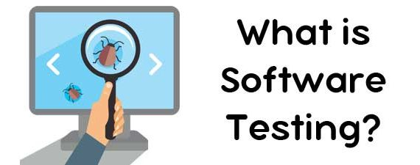
Software Test Levels
What is Software Testing?
Software testing is the process of evaluating and verifying ythat a software product or application does what is suppose to do.
Image Source:
https://www.inwizards.com/blog/software-testing-type-testing-introduction-basics-importance/
Notes:
Left (White Color space):
Title - Parent Topic
Subtitle - Subtopic 1
Body Text - Description in bullets
Right (Grey Color Space):
Body Text - Relevant image (with source)/code snippet
Software testing is a process of identifying the correctness of software by considering its all attributes (Reliability, Scalability, Portability, Re-usability, Usability) and evaluating the execution of software components to find the software bugs or errors or defects.
Reference:
https://www.inwizards.com/blog/software-testing-type-testing-introduction-basics-importance/

Slide 14
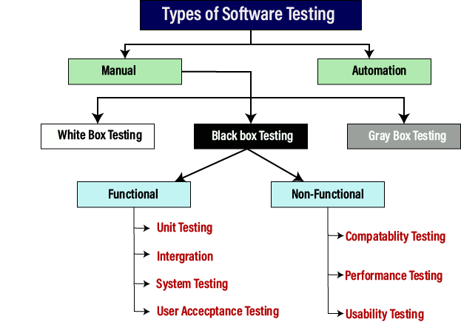
Software Test Levels
Types of Software Testing
Manual Testing
Automation Testing
Image Source:
https://www.javatpoint.com/software-testing-tutorial
Notes:
Left (White Color space):
Title - Parent Topic
Subtitle - Subtopic 2
Body Text - Description in bullets
Right (Grey Color Space):
Body Text - Relevant image (with source)/code snippet
Manual Testing:
Manual testing is the process of testing the software by hand to learn more about it, to find what is and isn’t working.
Automation Testing:
Automation testing is the process of testing the software using an automation tool to find the defects.
Reference:
https://www.javatpoint.com/software-testing-tutorial

Slide 15
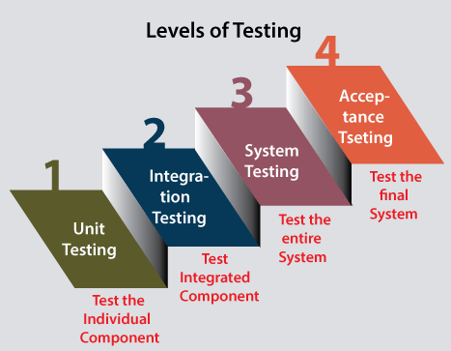
Software Test Levels
Levels of Testing
Unit Testing
Integration Testing
System Testing
Acceptance Testing
Image Source:
https://www.javatpoint.com/levels-of-testing
Notes:
Left (White Color space):
Title - Parent Topic
Subtitle - Subtopic 3
Body Text - Description in bullets
Right (Grey Color Space):
Body Text - Relevant image (with source)/code snippet
Unit Testing: checks if software components are fulfilling functionalities or not.
Integration Testing: checks the data flow from one module to other modules.
System Testing: evaluates both functional and non-functional needs for the testing.
Acceptance Testing: checks the requirements of a specification or contract are met as per its delivery
Reference:
https://www.javatpoint.com/levels-of-testing

